Slide 1


CAMPUS RECRUITMENT SYSTEM
By: Anshuman Babbar , Akansha , Gurneet Kaur

Slide 2
Features
Employer
Add new Jobs
Add new Jobs
Edit new jobs
Edit new jobs
View all Job Applications
View all Job Applications
View own profile
View own profile
Edit own Profile
Edit own Profile
Change the status of candidates
Change the status of candidates
Access to all Employers
Access to all Candidates
View candidate-job count
View the detail of the all users
View all Listed Jobs
View all Listed Jobs
Apply jobs
Edit Profile
Edit Profile
View own profile
View own profile
Edit Education Detail
Edit Education Detail
view the status of applied jobs
view the status of applied jobs
Admin
Candidate

Slide 3


GOAL OF THis SPRINT:
Candidate Part :
Edit Profile
Add or Update education Detail
View Job Applied
Apply Job
Admin Part:
View all the employers and candidates
View all job posts

Slide 4

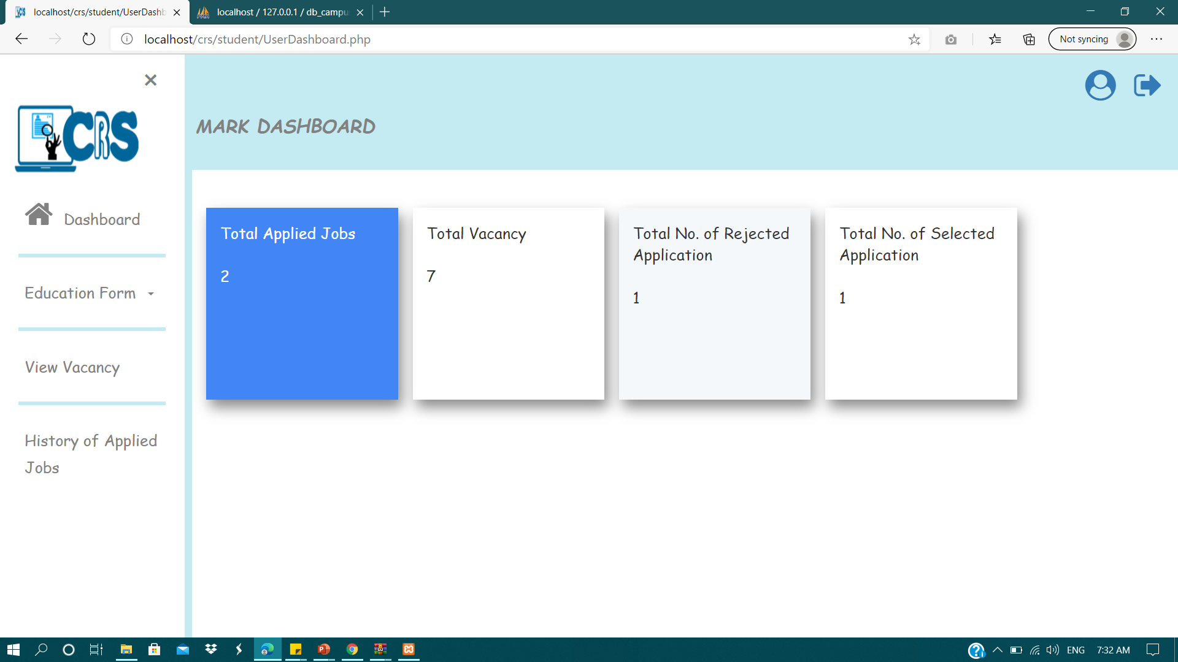
As a candidate:
I want to Register so that I can see my Dashboard.
Given:
As a candidate:
I am registered to system
When:
I click login
Then:
I can see my dashboard with all job notifications and history

Slide 5
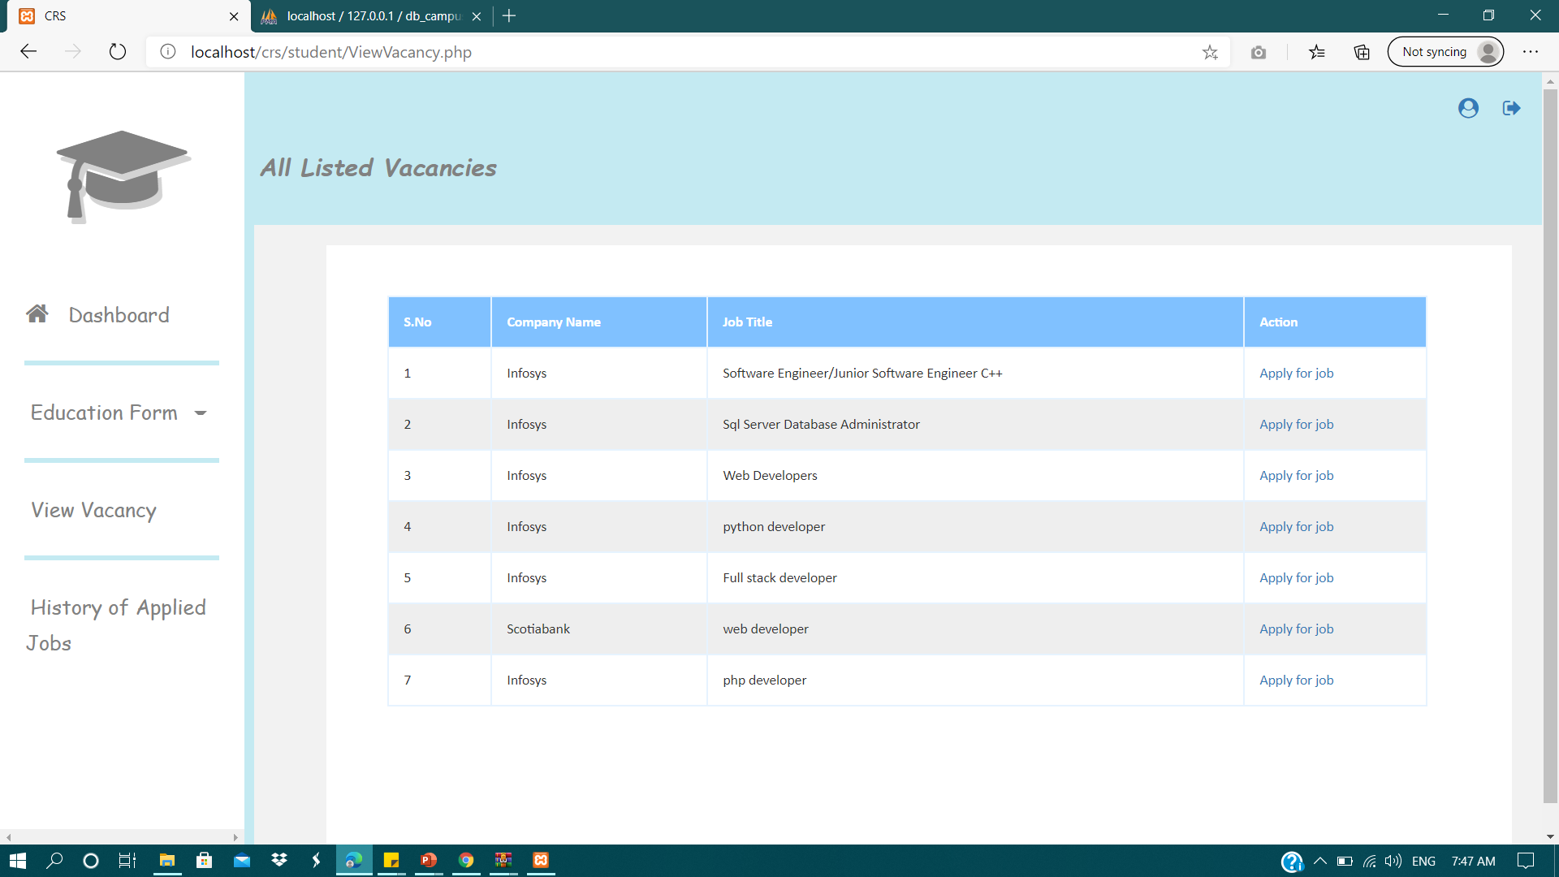
As a candidate:
I want to view all the latest jobs so that I can apply without any hassle
Given:
I am login to system
When:
I click on view jobs
Then:
I can see my all jobs related to skill

Slide 6
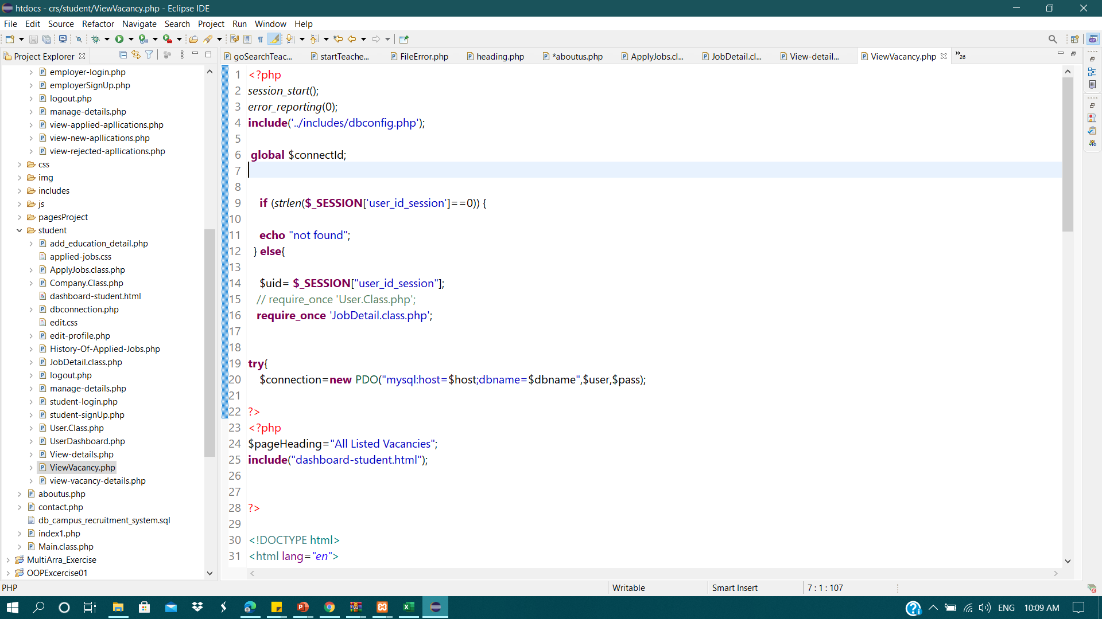
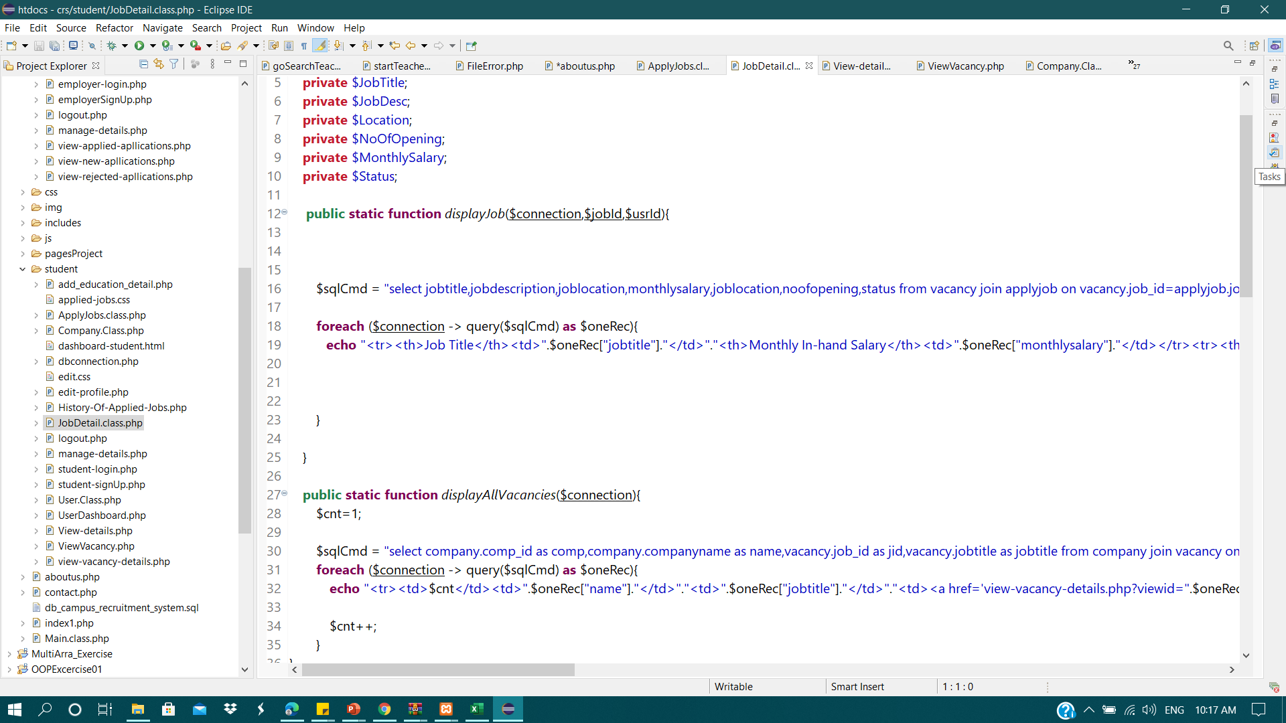
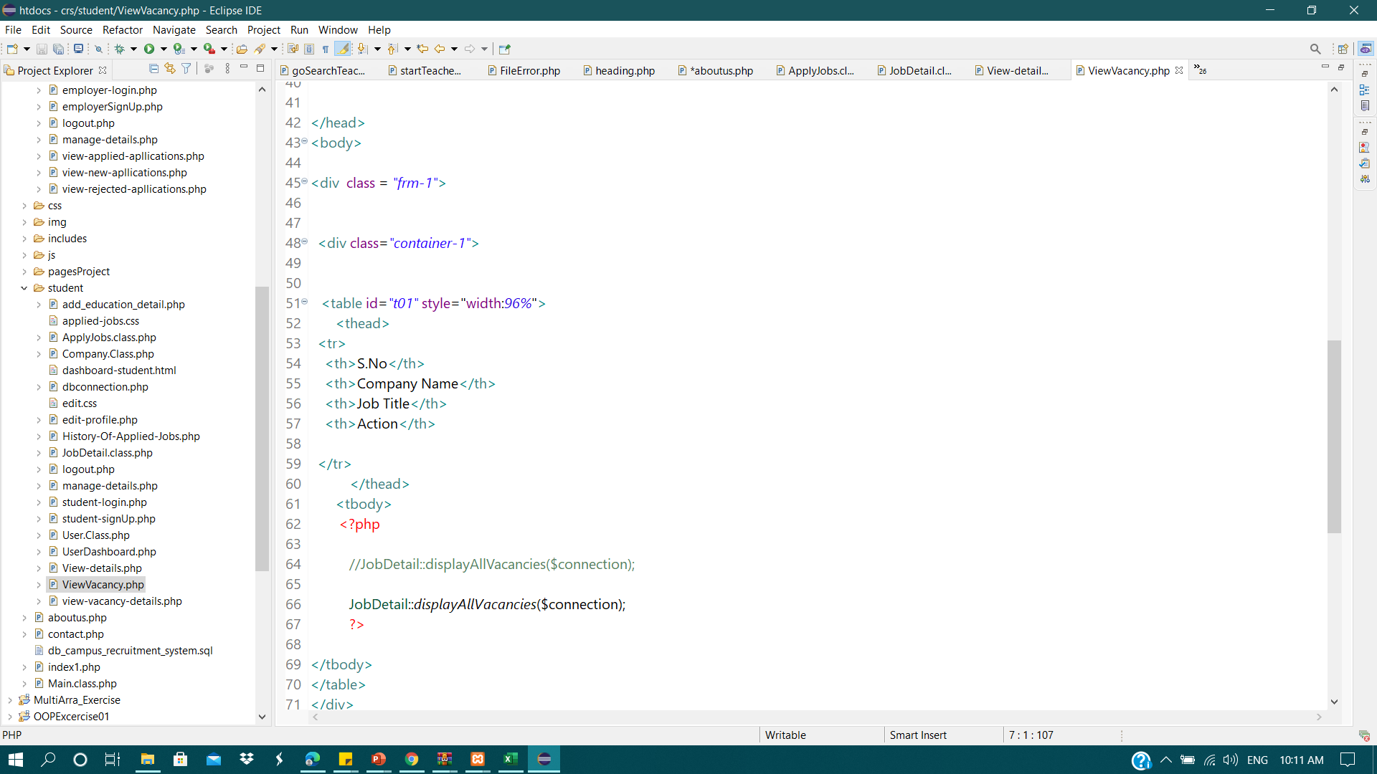
View Vacancy Page Code:
JobDetail.class

Slide 7
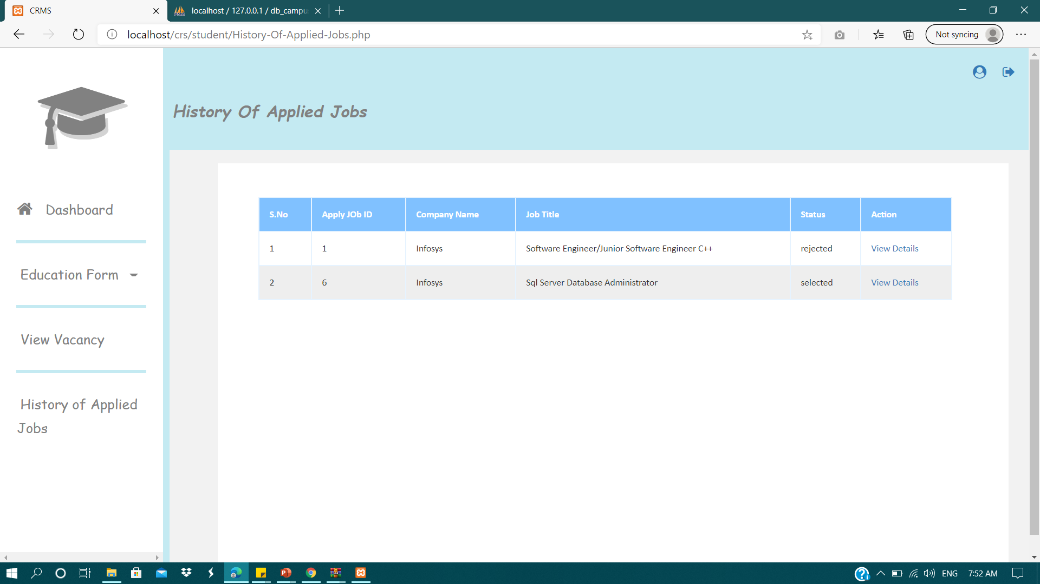
As a candidate:
I want to view applied jobs so that I can know the status of Applied Jobs..
Given:
I am on my dashboard
When:
I click on History of applied jobs
Then:
I want to see that jobs with their application status.

Slide 8
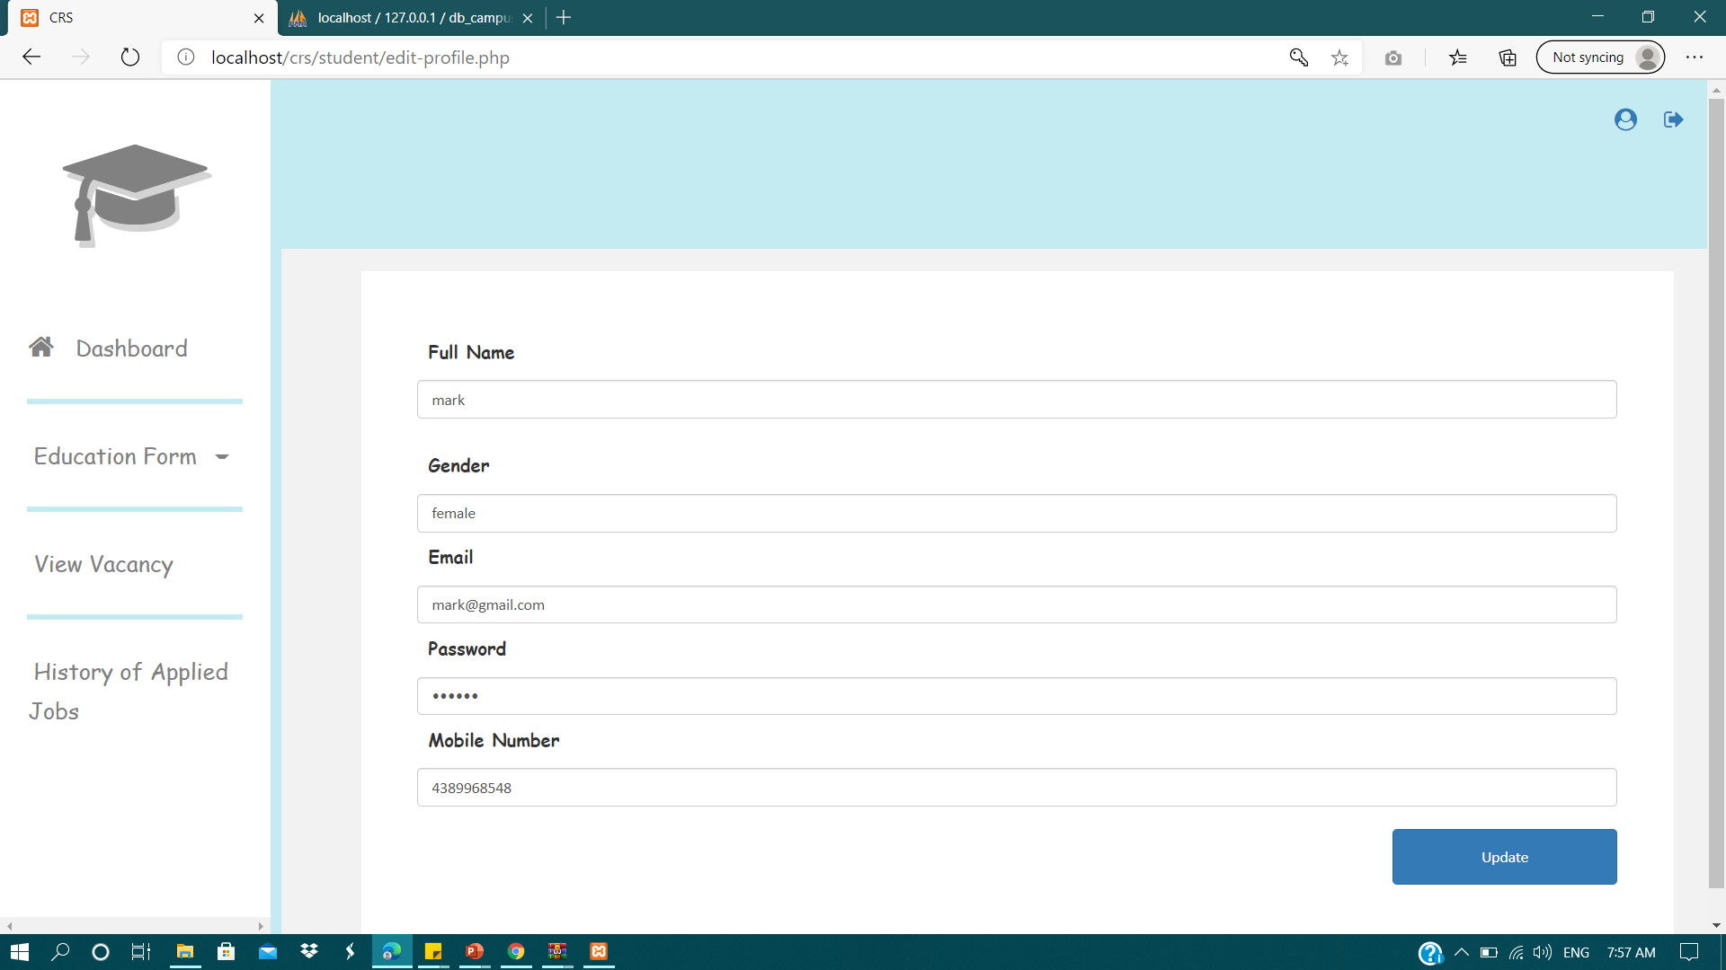
As a candidate:
I want to Update my Profile so that I can edit my information.
Given:
I want to update my profile
When:
I click on Profile icon on the top right
Then:
I can change any information related to me.

Slide 9
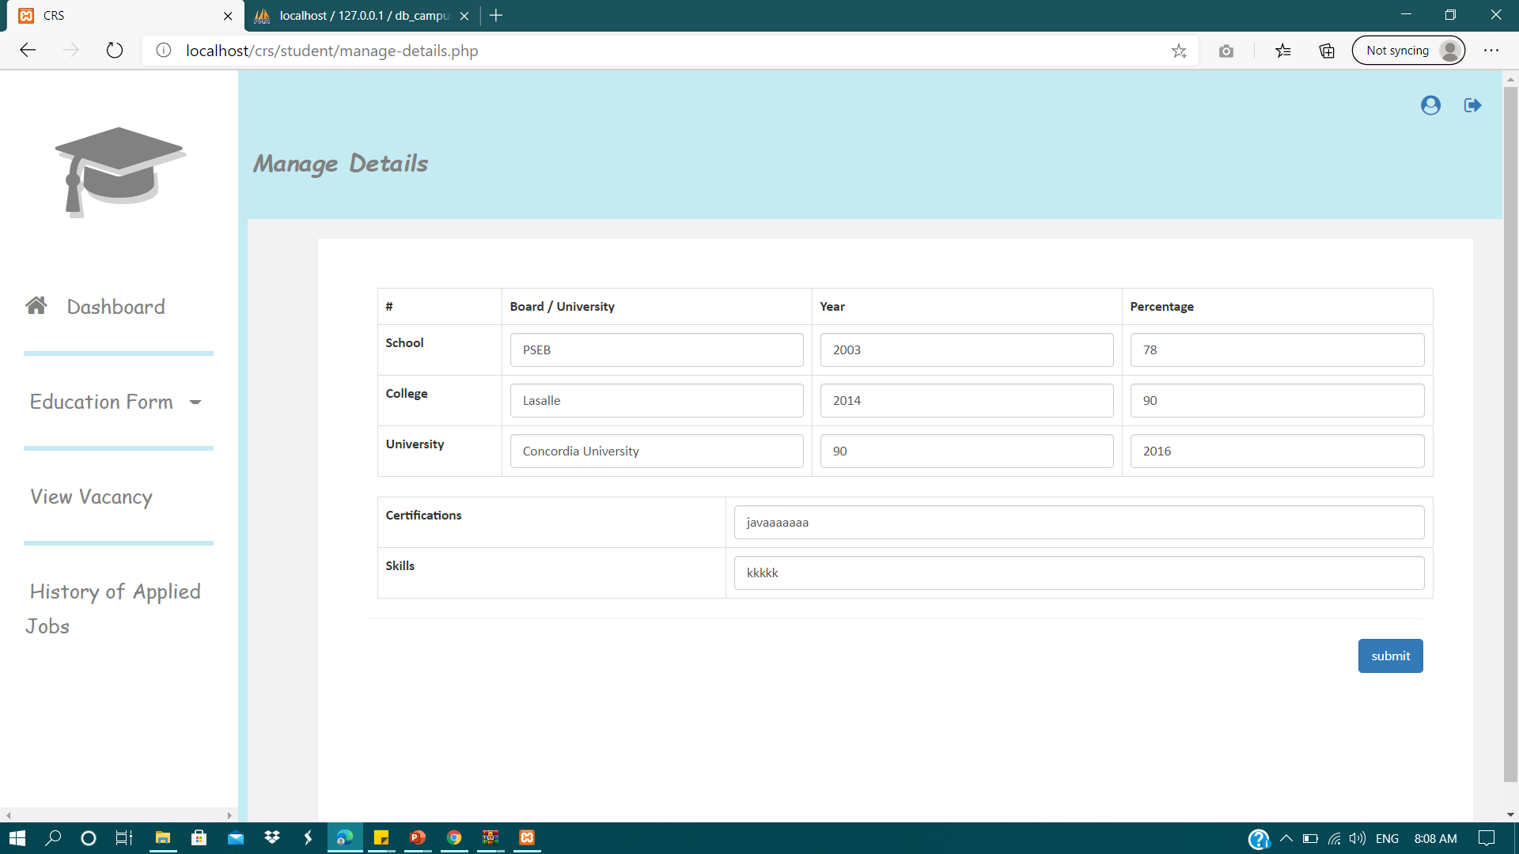
As a candidate:
I want to add or Update my Education Detail so that I can edit my academic information.
Given:
I want to update my academic detail
When:
I click on Education Form
Then:
I can add education detail if not added or update it if already added.

Slide 10
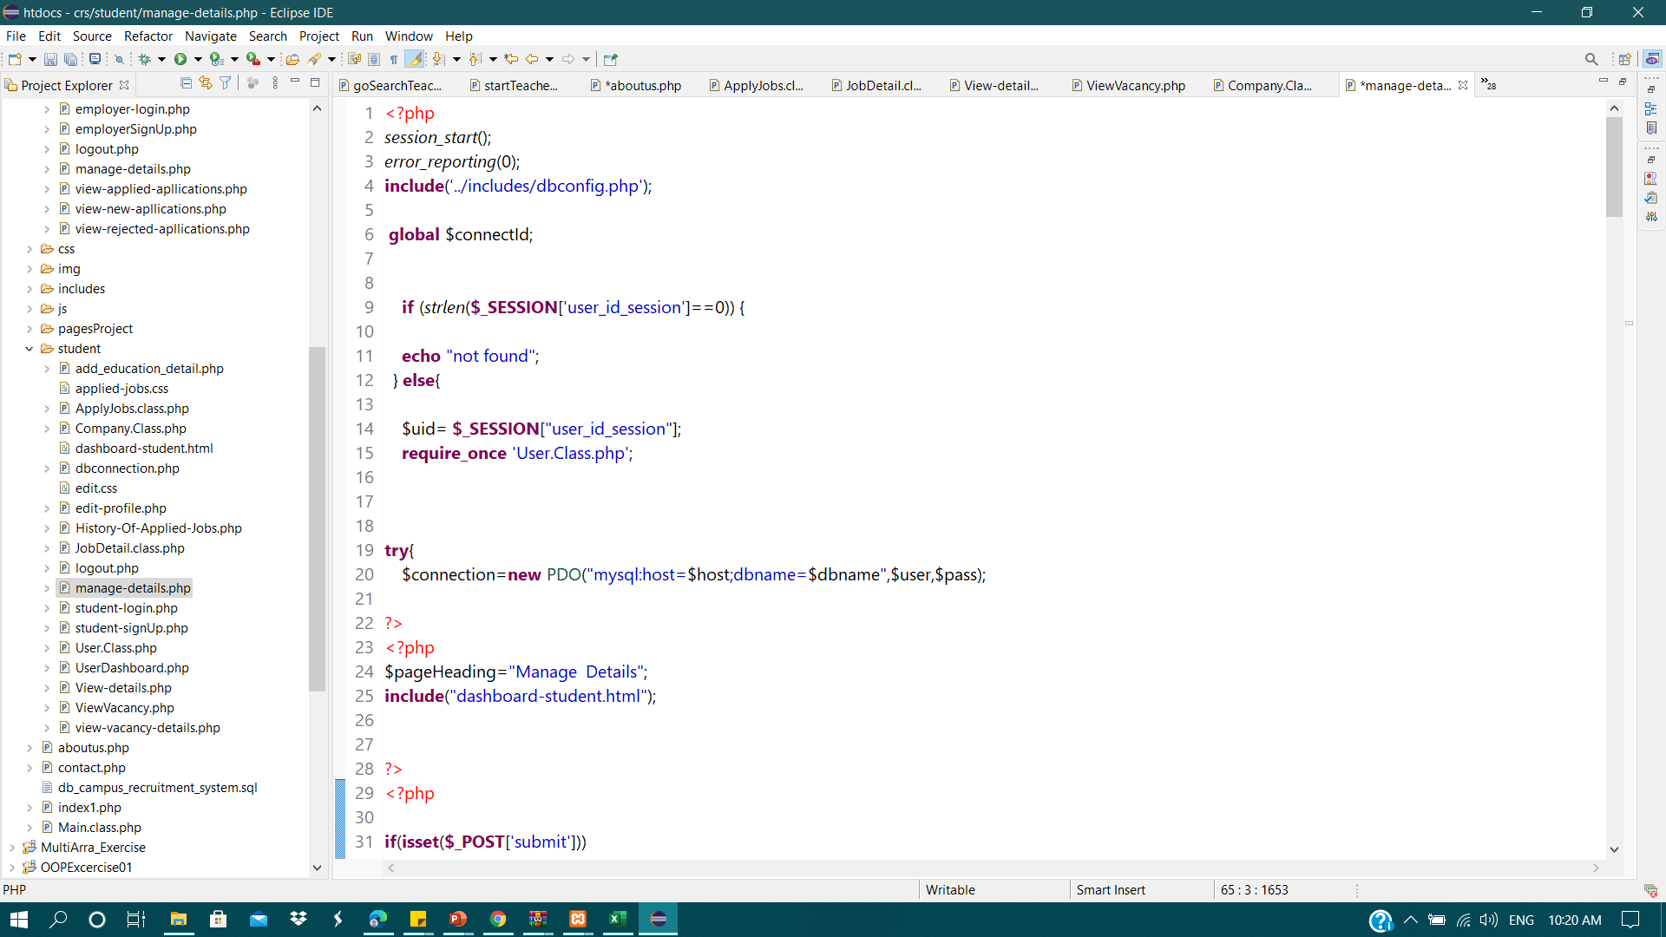
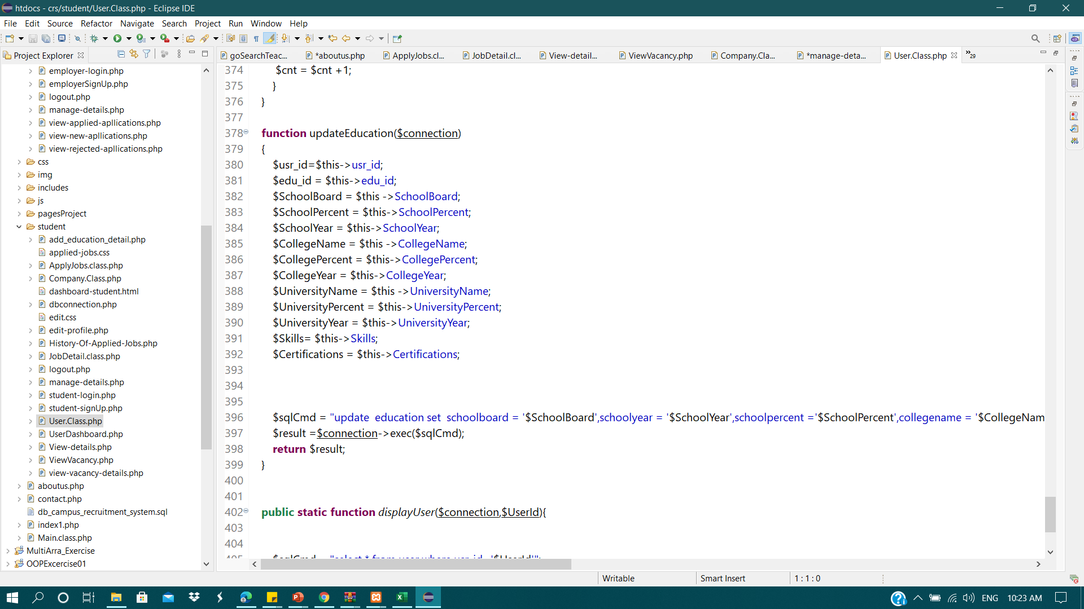
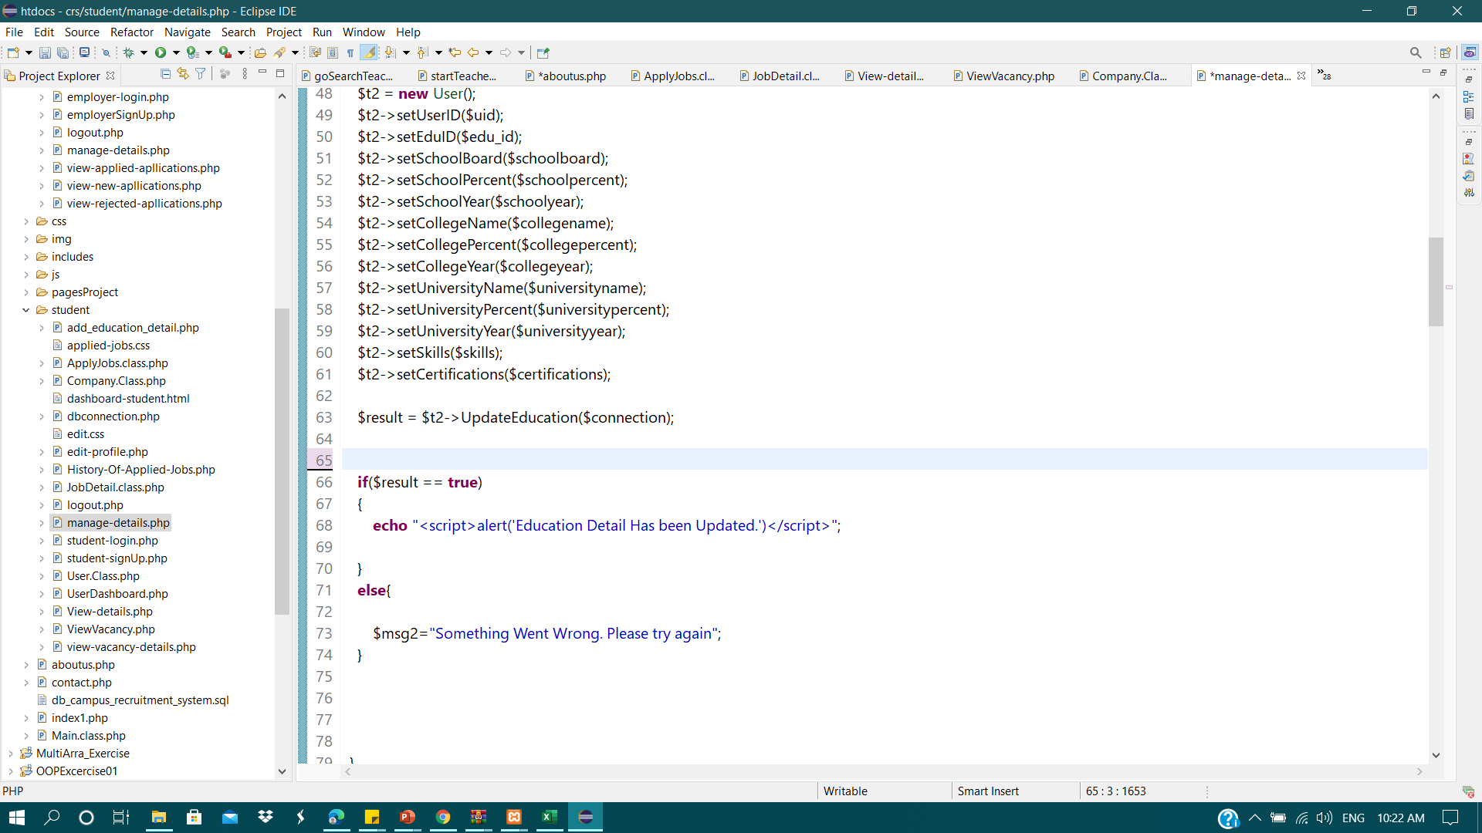
Update Education:
User.class

Slide 11
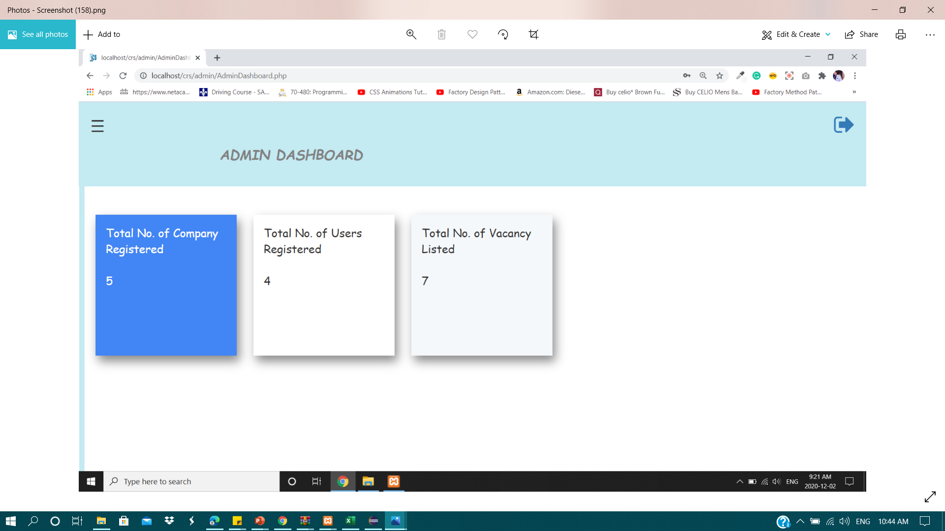
As aN ADMIN:
I want to see my dashboard so that I can have look on total number of candidates,employers and vacancies
Given:
I am login to the system
When:
I click on Dashboard
Then:
I can see dashboard which display total number of employers, candidates and vacancies.

Slide 12
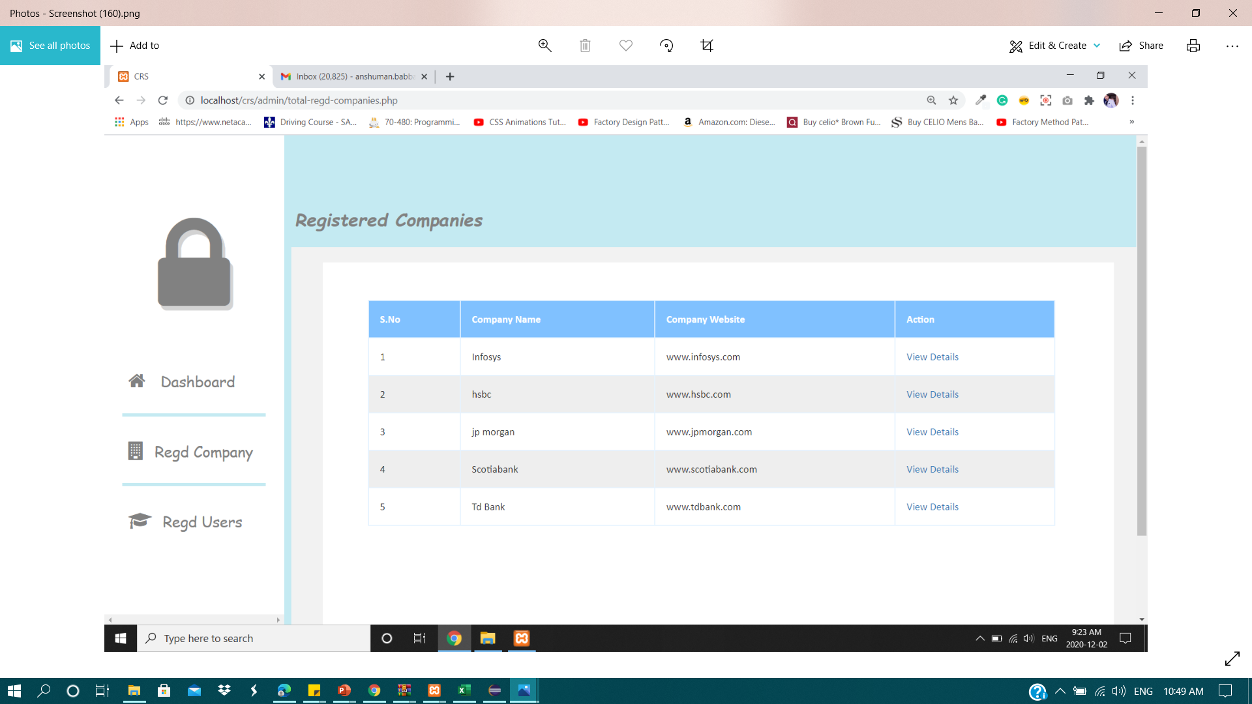
As aN admin:
I want to see all the employers or companies that have registered here
Given:
I am logged in
When:
I click on Regd Company
Then:
I can see all the companies and their details on further click on view details.

Slide 13
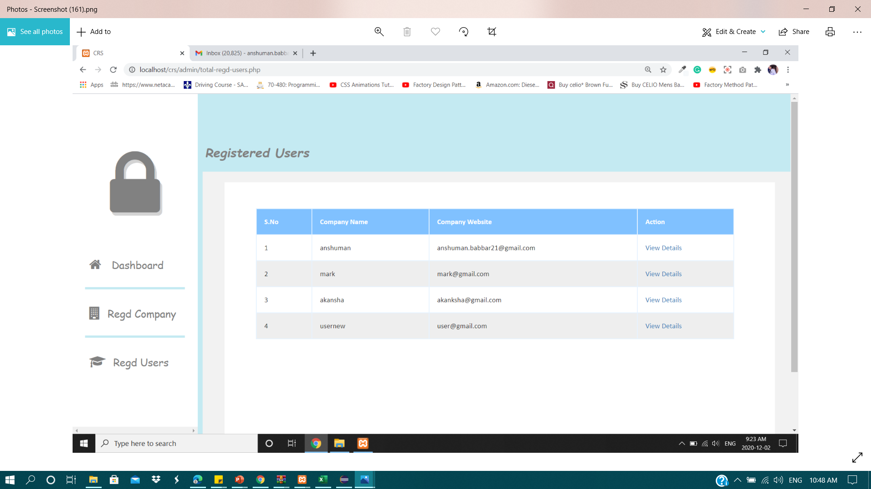
As aN admin:
I want to see all the users that have registered here
Given:
I am logged in
When:
I click on Regd Users
Then:
I can see all the users and their details on further click on view details.

Slide 14
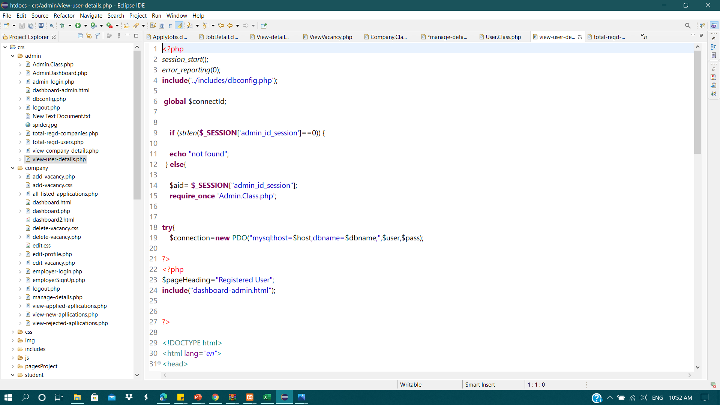
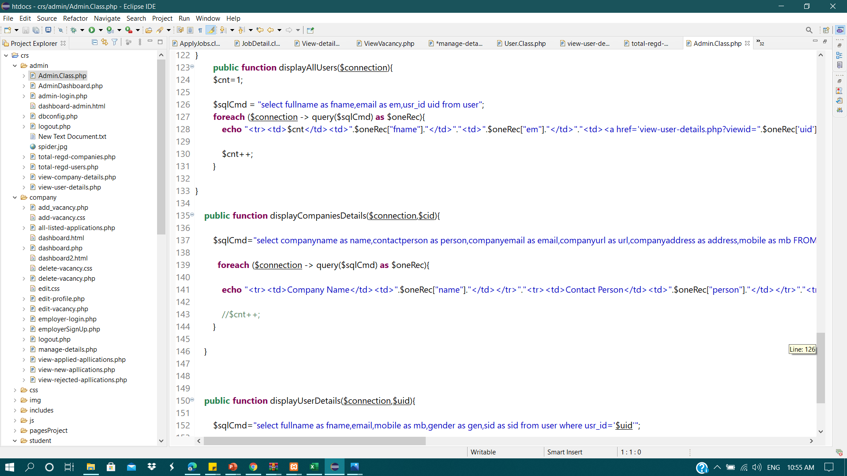
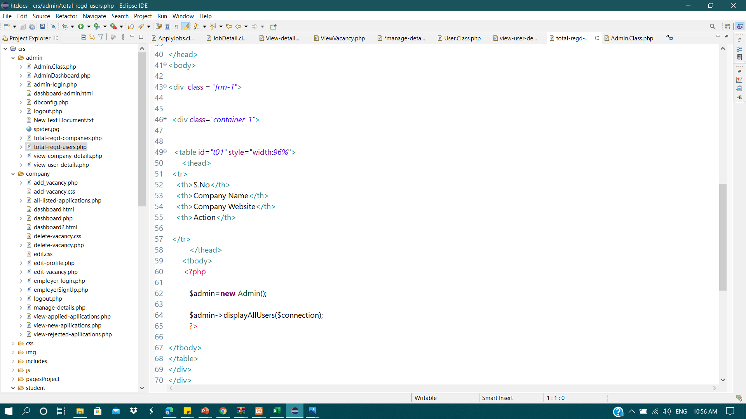
View users:
Admin.class

Slide 15

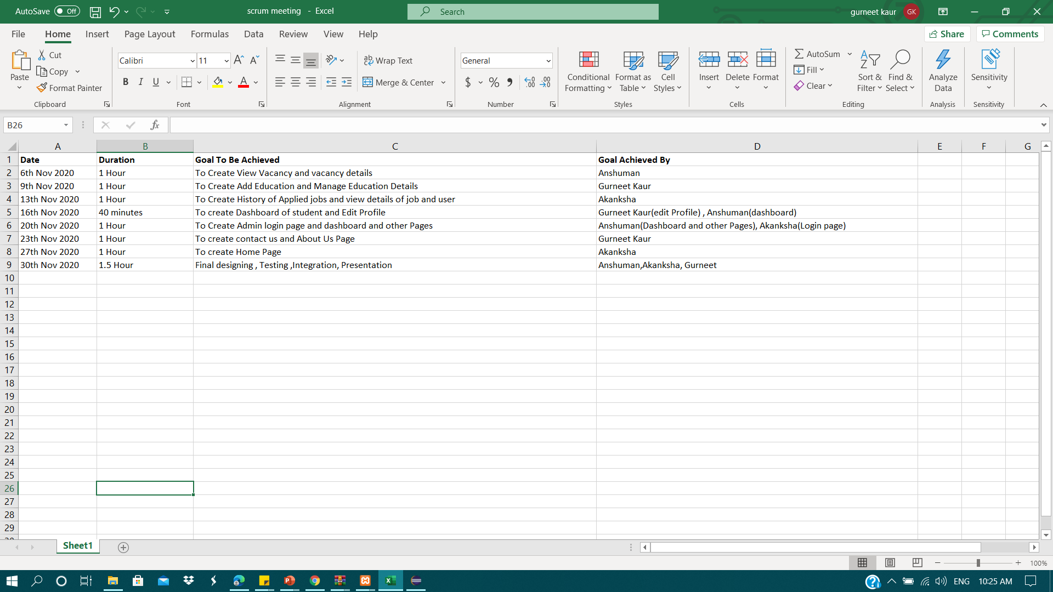
Timeline
2 meetings every week
Problems discussed,tasks divided
Duration 40-60 mins.

Slide 16
Vacancy
Admin
Job_id | Int(10)
Comp_id | Int(10)
Jobtitle | Varchar(100)
jobdescription | Varchar(500)
joblocation | Varchar(30)
noofopening | Varchar(10)
monthlysalary | Varchar(10)
User
admin_id | Int(10)
adminname | Varchar(50)
email | Varchar(100)
mobile | Varchar(20)
username | Varchar(50)
password | Varchar(50)
Aboutus
usr_id | Int(10)
fullname | Varchar(50)
email | Varchar(100)
mobile | Varchar(20)
gender | Varchar(20)
password | Varchar(50)
sid | Varchar(50)
id | Int(10)
title | Varchar(100)
description | Varchar(200)
Education
educationid | Int(10)
Usr_id | Int(10)
schoolboard | Varchar(20)
schoolyear | Varchar(10)
schoolpercent | Varchar(5)
collegename | Varchar(20)
collegeyear | Varchar(10)
collegepercent | Varchar(5)
universityname | Varchar(30)
universityyear | Varchar(10)
universitypercent | Varchar(5)
certifications | Varchar(100)
skills | Varchar(100)
Company
Contact
Comp_id | Int(10)
companyname | Varchar(100)
contactperson | Varchar(100)
companyemail | Varchar(100)
password | Varchar(100)
mobile | Varchar(20)
companyurl | Varchar(50)
comapnyaddress | Varchar(100)
id | Int(10)
address | Varchar(100)
email | Varchar(50)
mobile | Varchar(12)
applyjob_id | Int(10)
Job_id | Int(10)
Usr_id | Int(10)
remark | Varchar(100)
status | Varchar(100)
Apply Job

Slide 17
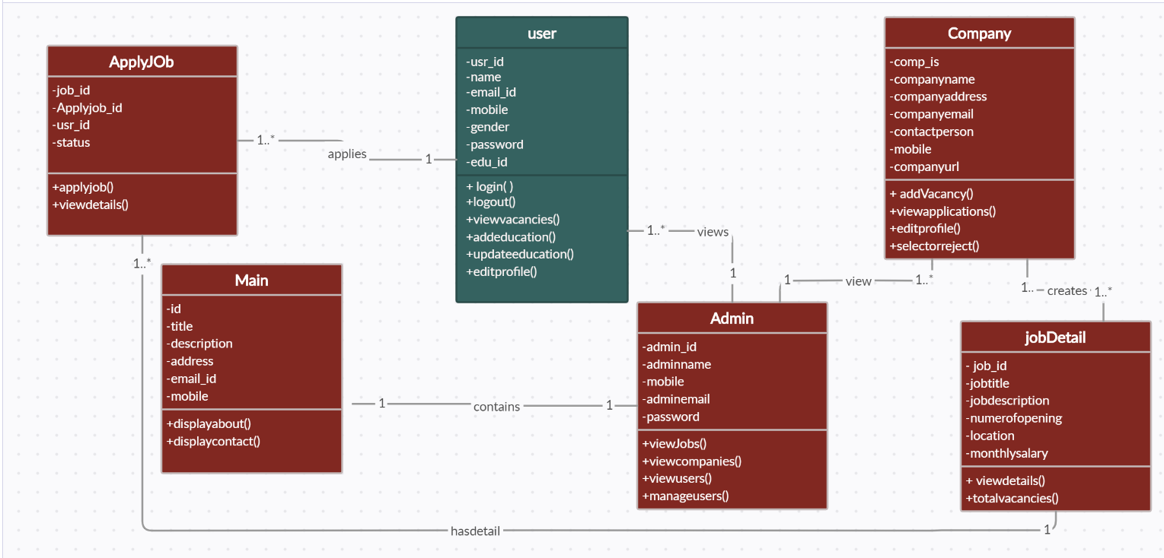
Class diagram:

Slide 18
Major item that went well
Task Achievement
Cooperation within the team

Slide 19

Changes made:
Use of PDO
Candidate part
Admin part
Other pages of the website(Aboutus , ContactUS)
Tables added in the database
Improved GUI

Slide 20


Further improvement:
More optimized code
Learning more to make it more professional

Slide 21

Thank You
Everyone

